Slide 1
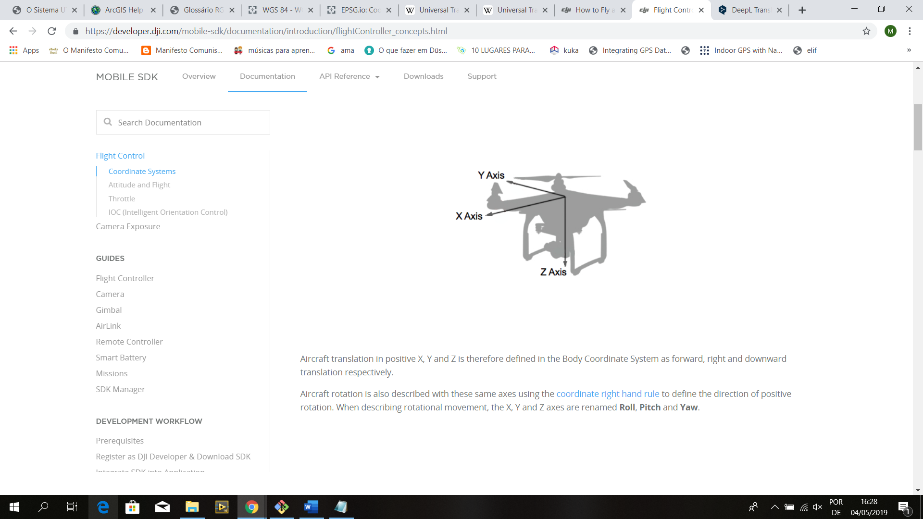
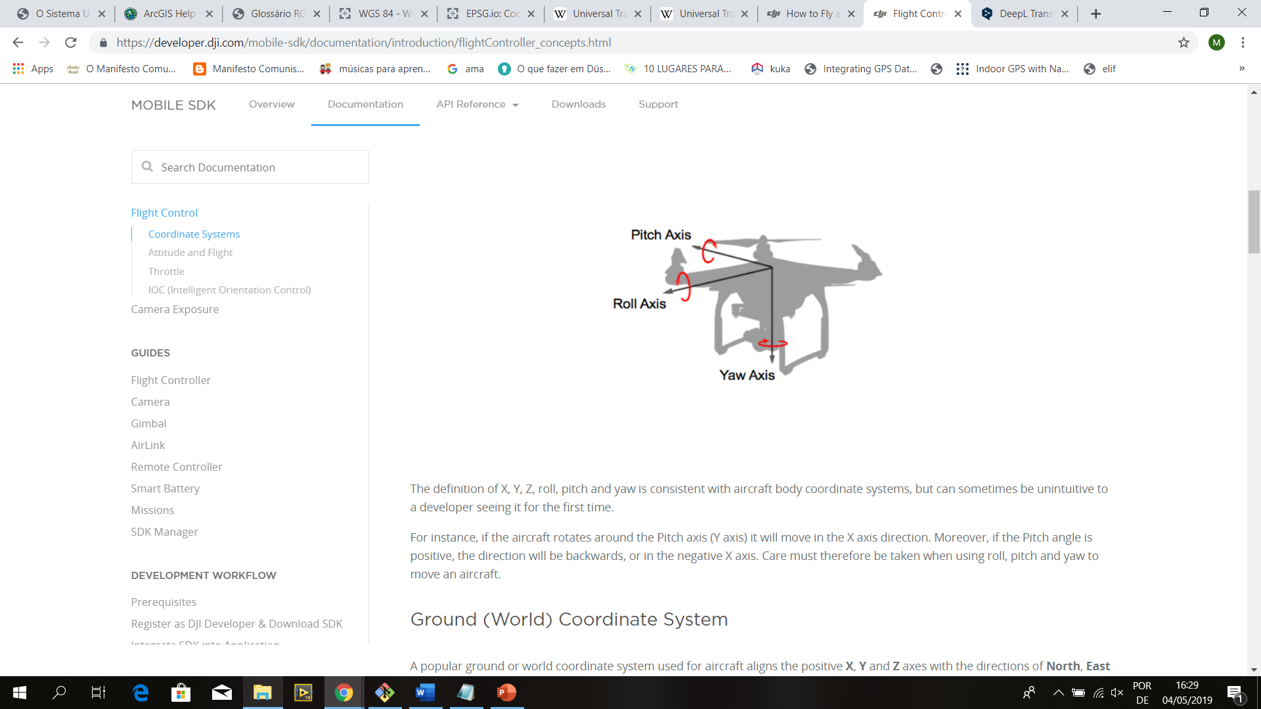

Slide 2
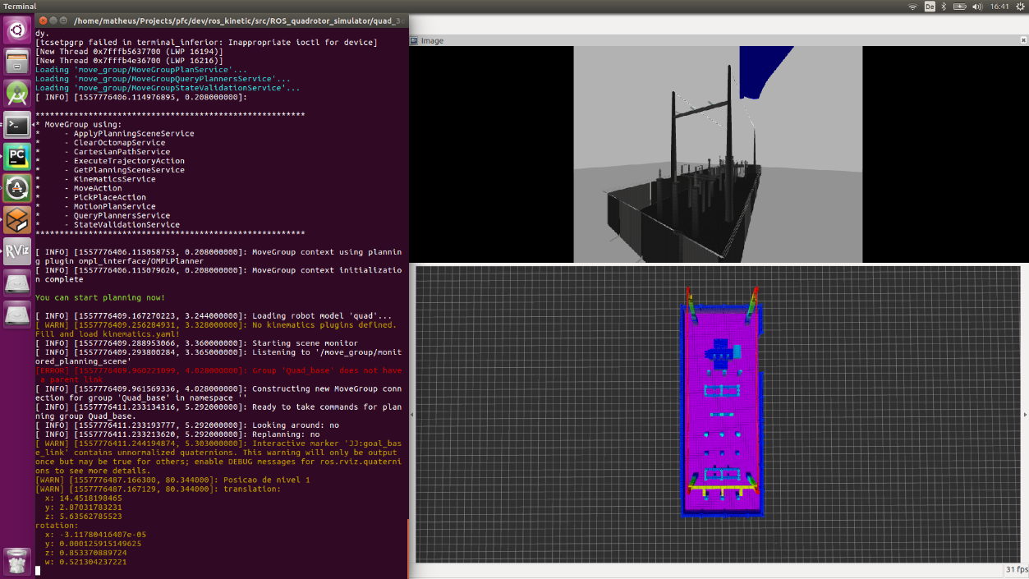

Slide 3
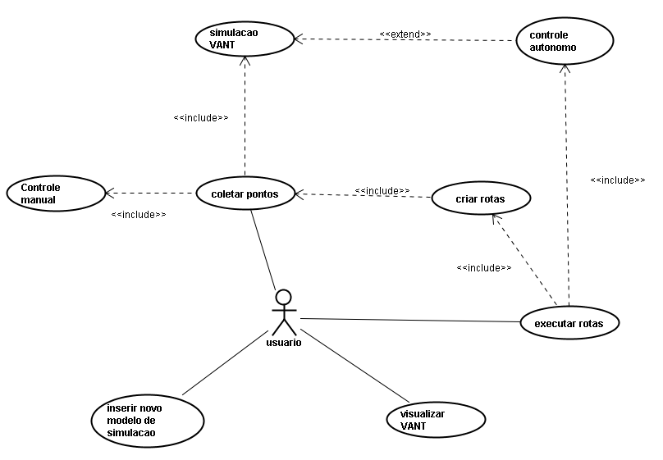

Slide 4
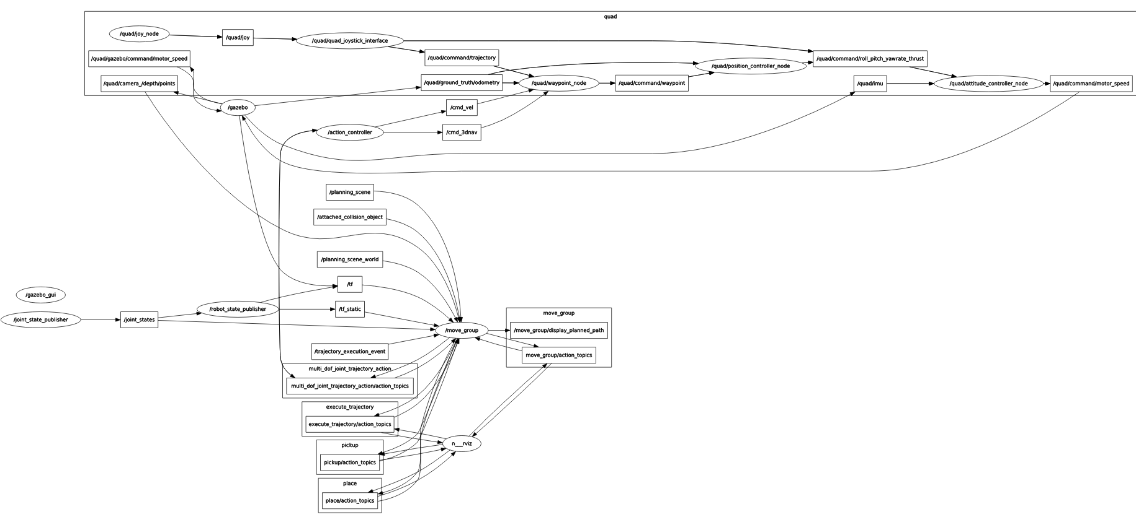

Slide 5
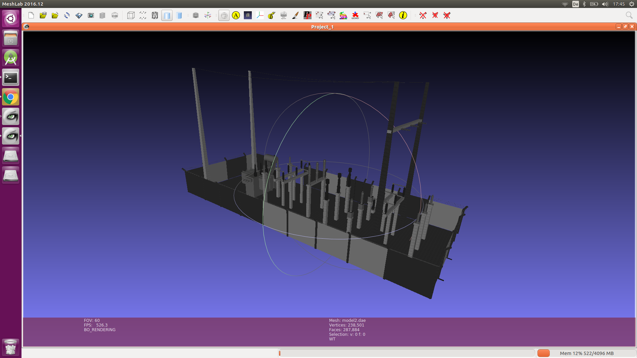

Slide 6
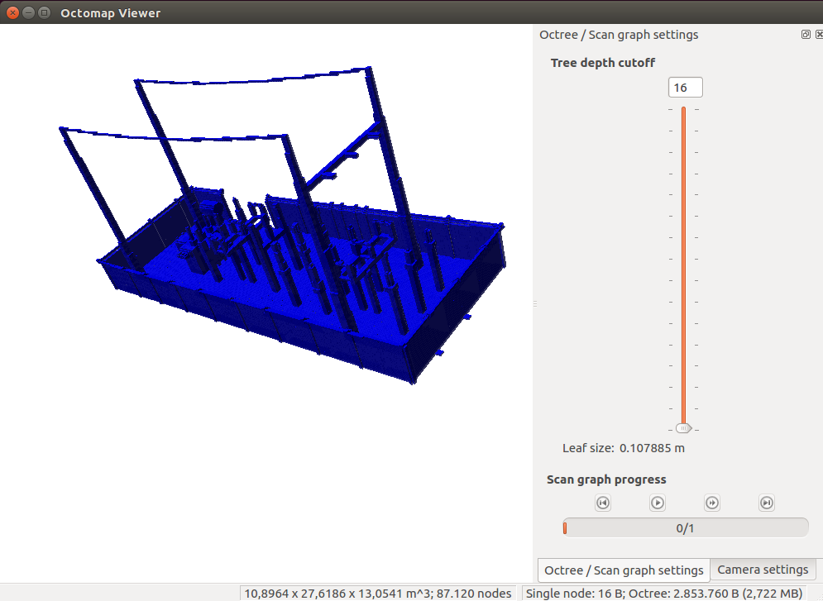

Slide 7
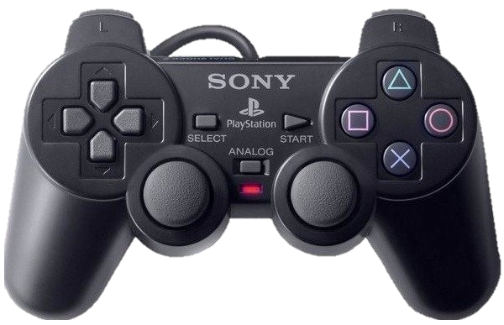
Coletar pontos
Armazenar pontos coletados
L1 – Modo autônomo
R2 – Zerar pontos
Aumentar nível
Modo manual
Diminuir nível
Controles analógicos para movimentação do VANT
Roll
Yaw
Pitch
Thrust

Slide 8


Slide 9
Ponto Nível 1
Ponto Nível 1
Ponto Nível 1
Ponto de decisão 1
Ponto Nível 2
Ponto Nível 2
Execução da rota
Ponto Nível 2
Ponto Nível 2
Ponto de decisão 2
Ponto Nível 3
Ponto Nível 2
Ponto Nível 1
Ponto Nível 1

Slide 10
Y
1
1
1
1
1
2
2
2
3
X

Slide 11
1
1
1
1
1
2
2
2
3

Slide 12

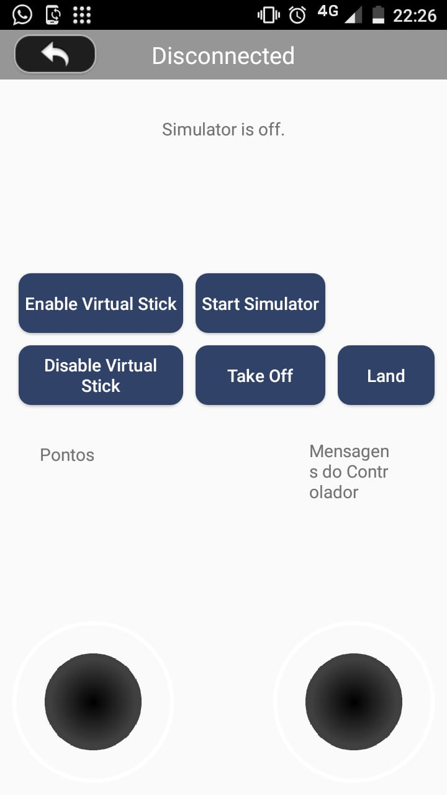

Yaw
Roll
Yaw
Roll
Thrust
Pitch
Thrust
Pitch

Slide 13
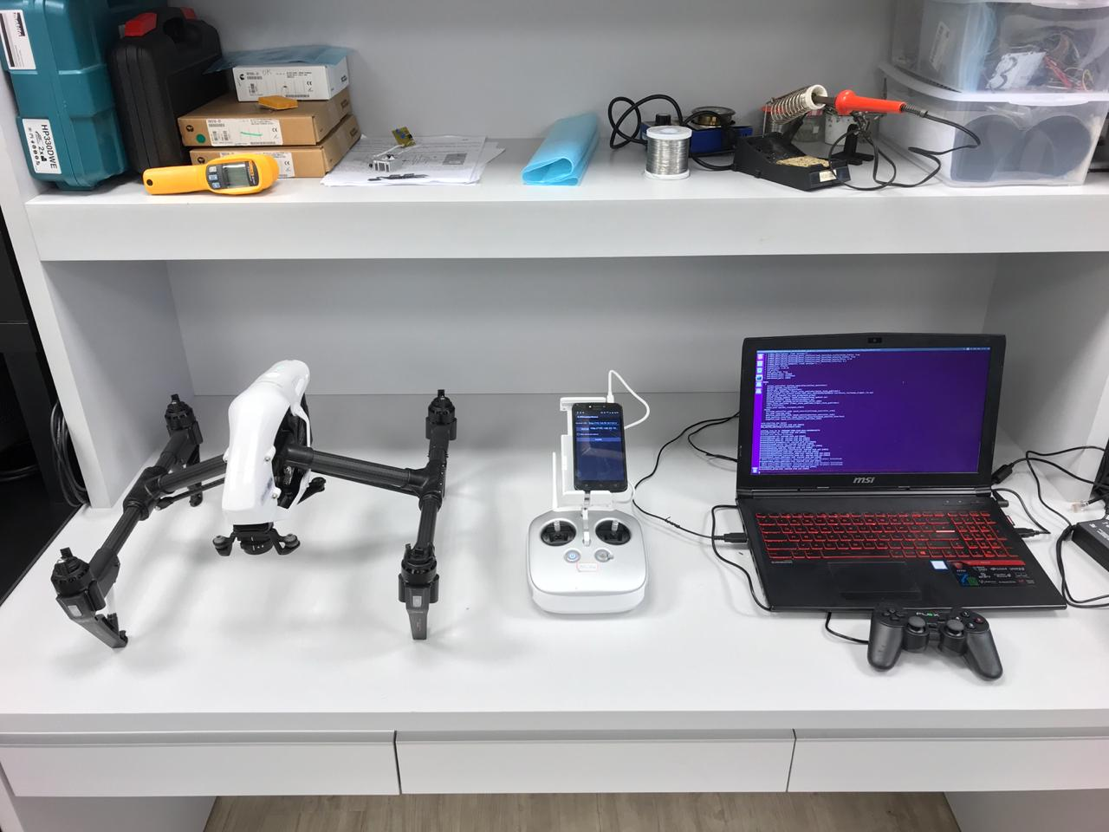
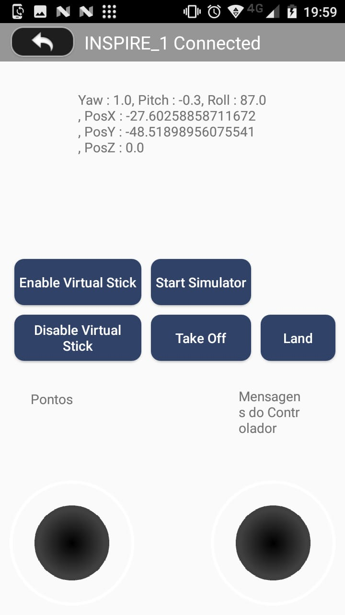

Slide 14
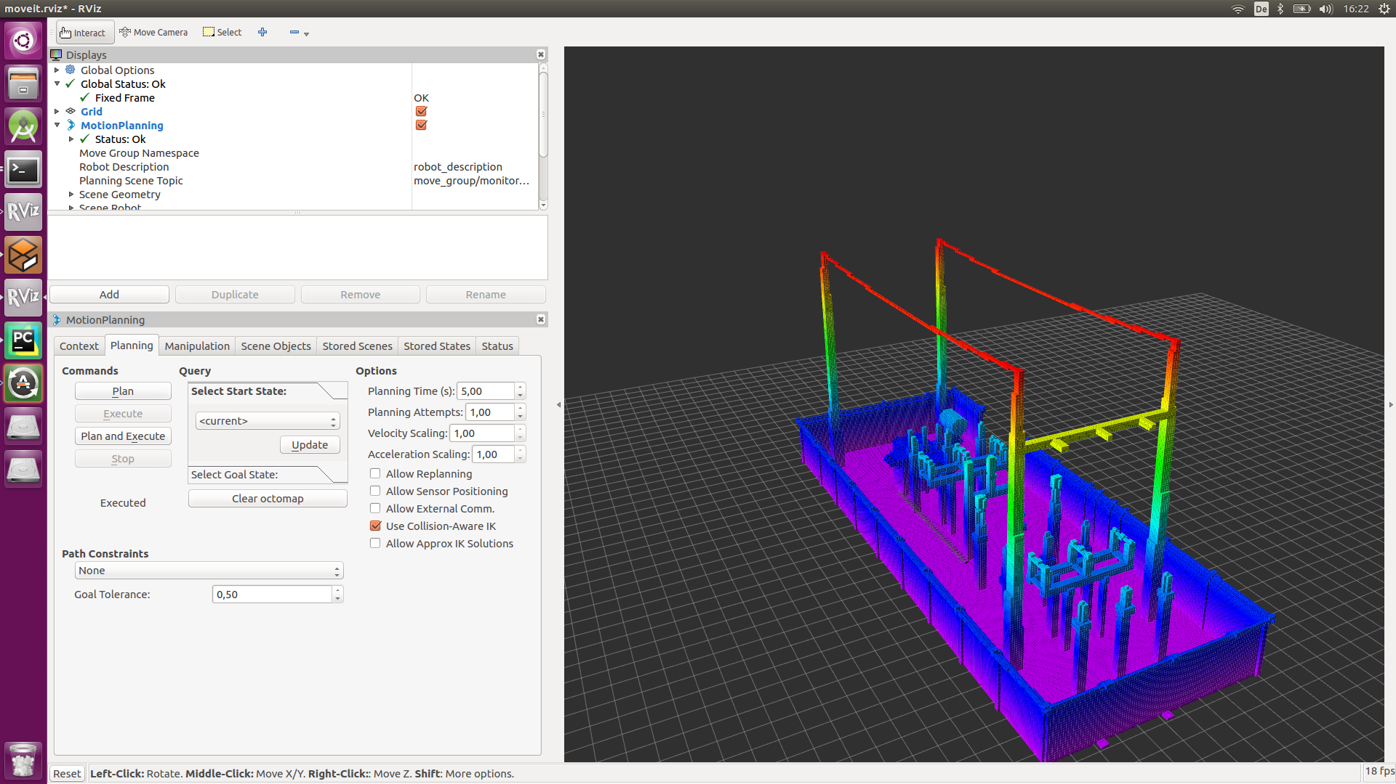
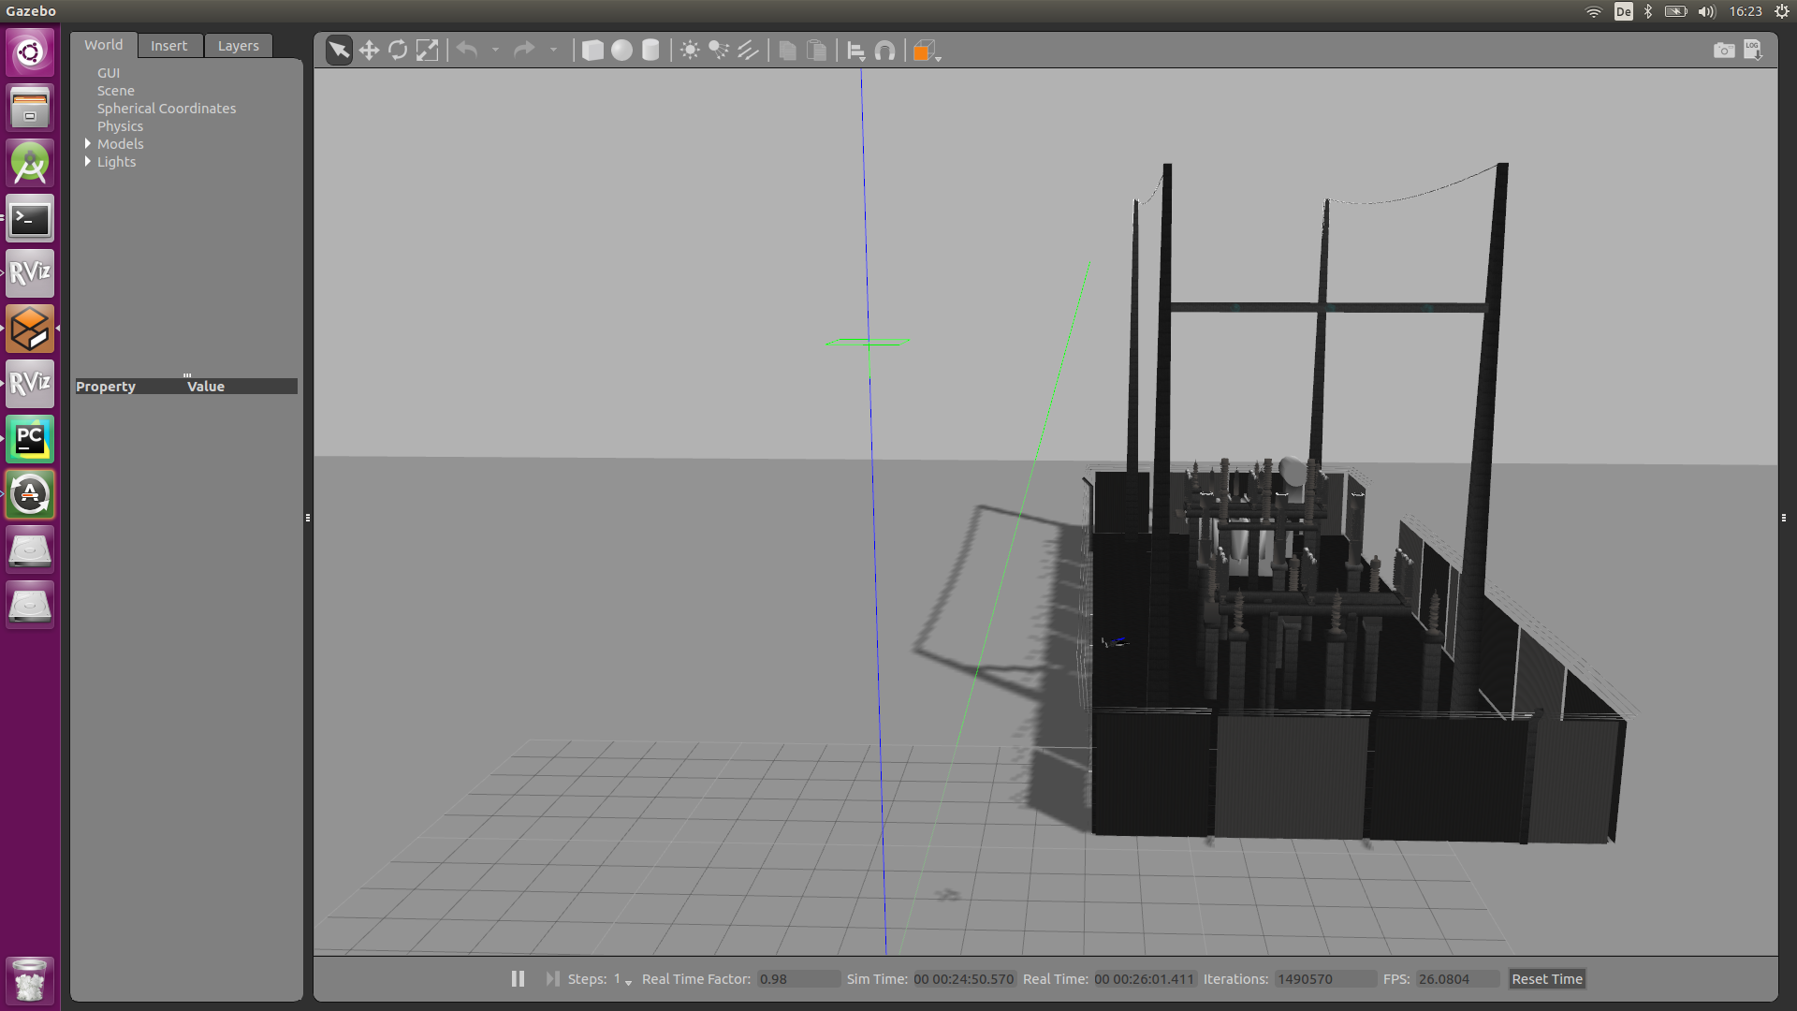

Slide 15
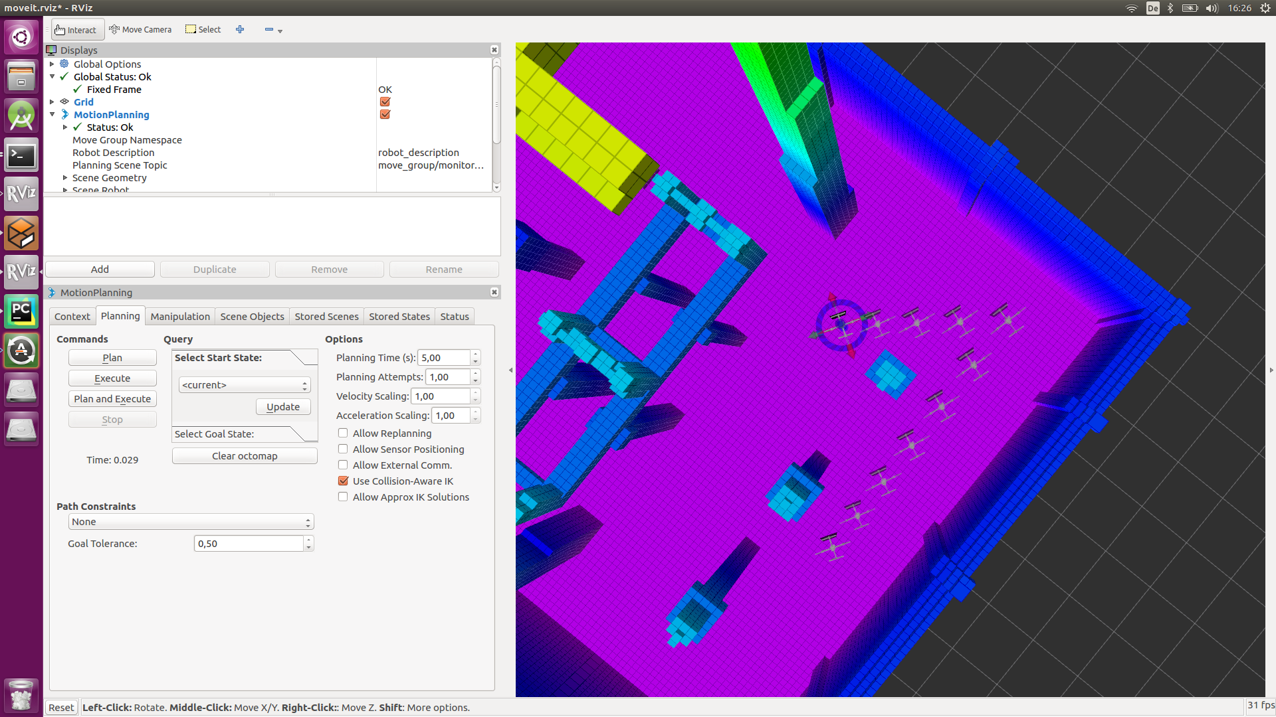
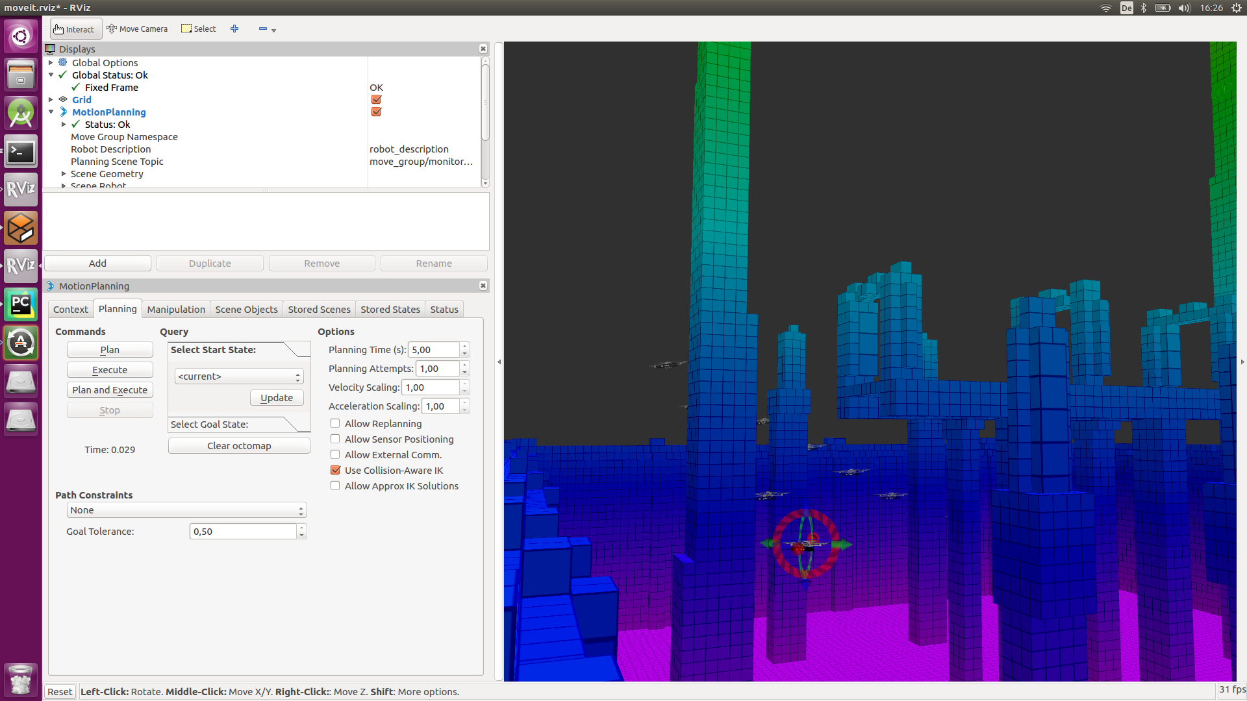

Slide 16
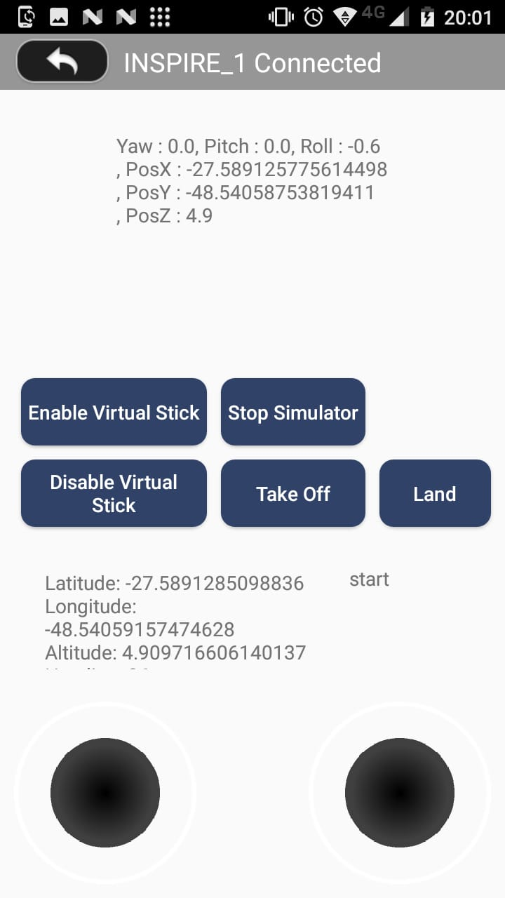
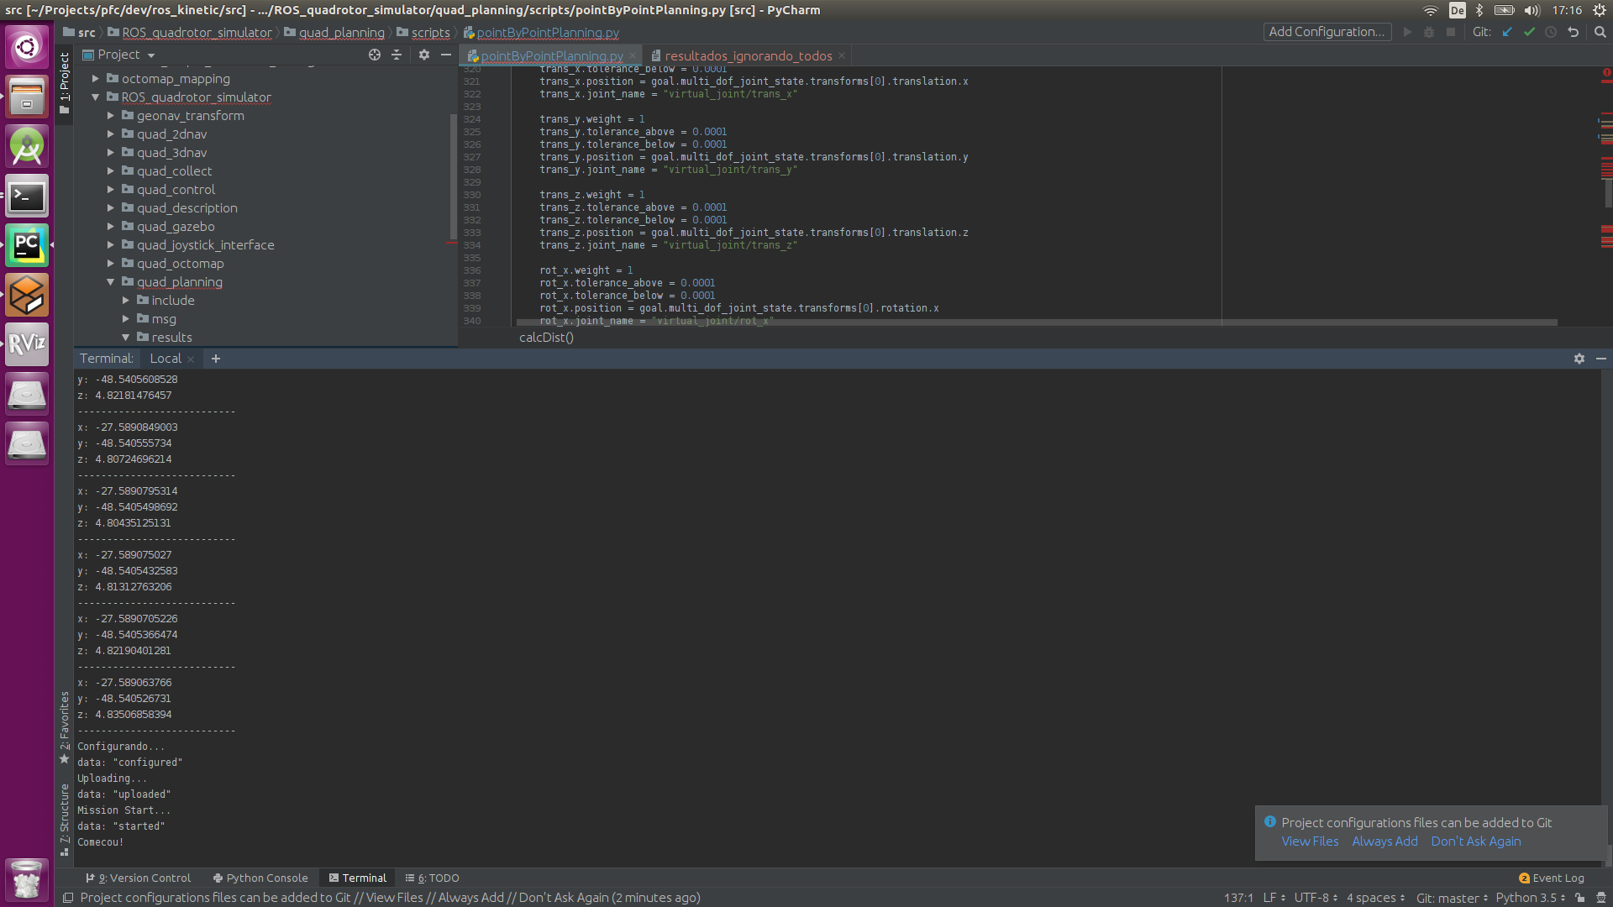

Slide 17
Sem rotas adaptativas
-27.5891285475 -48.540591562 triangle5 yellow 1 Starting point.
-27.5890637652 -48.5405267317 circle1 blue 2 A point..
-27.5889787869 -48.5405241637 circle1 blue 3 A point.
-27.5889377168 -48.5405268142 circle1 blue 4 A point.
-27.5888153161 -48.5405563245 circle1 blue 5 A point.
-27.5888256852 -48.5406222277 circle1 blue 6 A point.
-27.5888119607 -48.5406890478 circle1 blue 7 A point.
-27.588923083 -48.5406919469 circle1 blue 8 A point.
-27.5890005908 -48.5406967116 circle1 blue 9 A point.
-27.5892054268 -48.5406447217 cross5 red 10 End point.

Slide 18
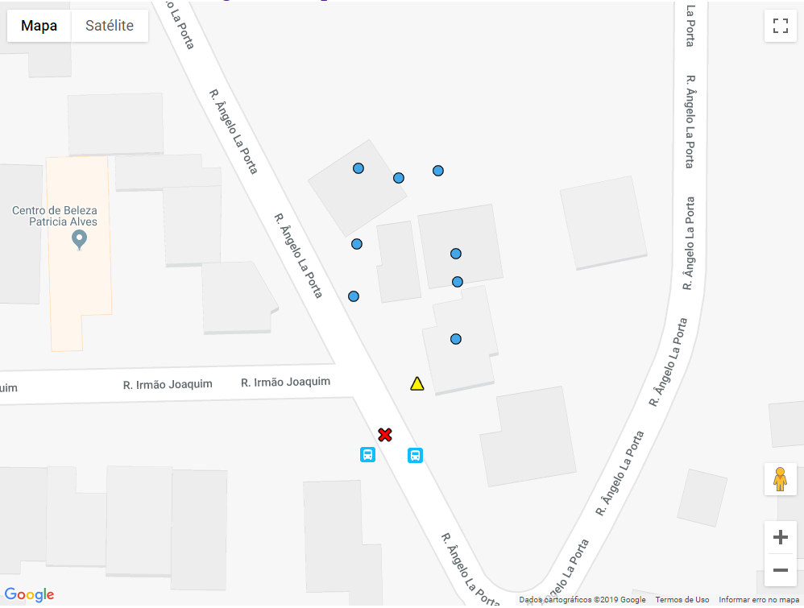

Slide 19
-27.5891285475 -48.540591562 triangle5 yellow 1 Starting point.
-27.5890637658 -48.5405267311 circle3 blue 2 A point..
-27.5889787869 -48.5405241634 circle3 blue 3 A point..
-27.5889936155 -48.5405705666 star3 green 4 A point..
-27.5889546266 -48.5405718932 star3 green 5 A point..
-27.5889377163 -48.5405268136 circle3 blue 6 A point..
-27.5888153177 -48.5405563248 circle3 blue 7 A point..
-27.5888256858 -48.5406222276 circle3 blue 8 A point..
-27.5888666623 -48.5406055765 star3 green 9 A point..
-27.5888119614 -48.5406890478 circle3 blue 10 A point..
-27.5889230831 -48.5406919471 circle3 blue 11 A point..
-27.5890005916 -48.5406967127 circle3 blue 12 A point..
-27.5889945709 -48.5406559848 star3 green 13 A point..
-27.5889345493 -48.5406480074 star3 green 14 A point..
-27.5892054254 -48.5406447209 cross5 red 15 End Point

Slide 20


Slide 21
http://www.copypastemap.com/map.php

Slide 22
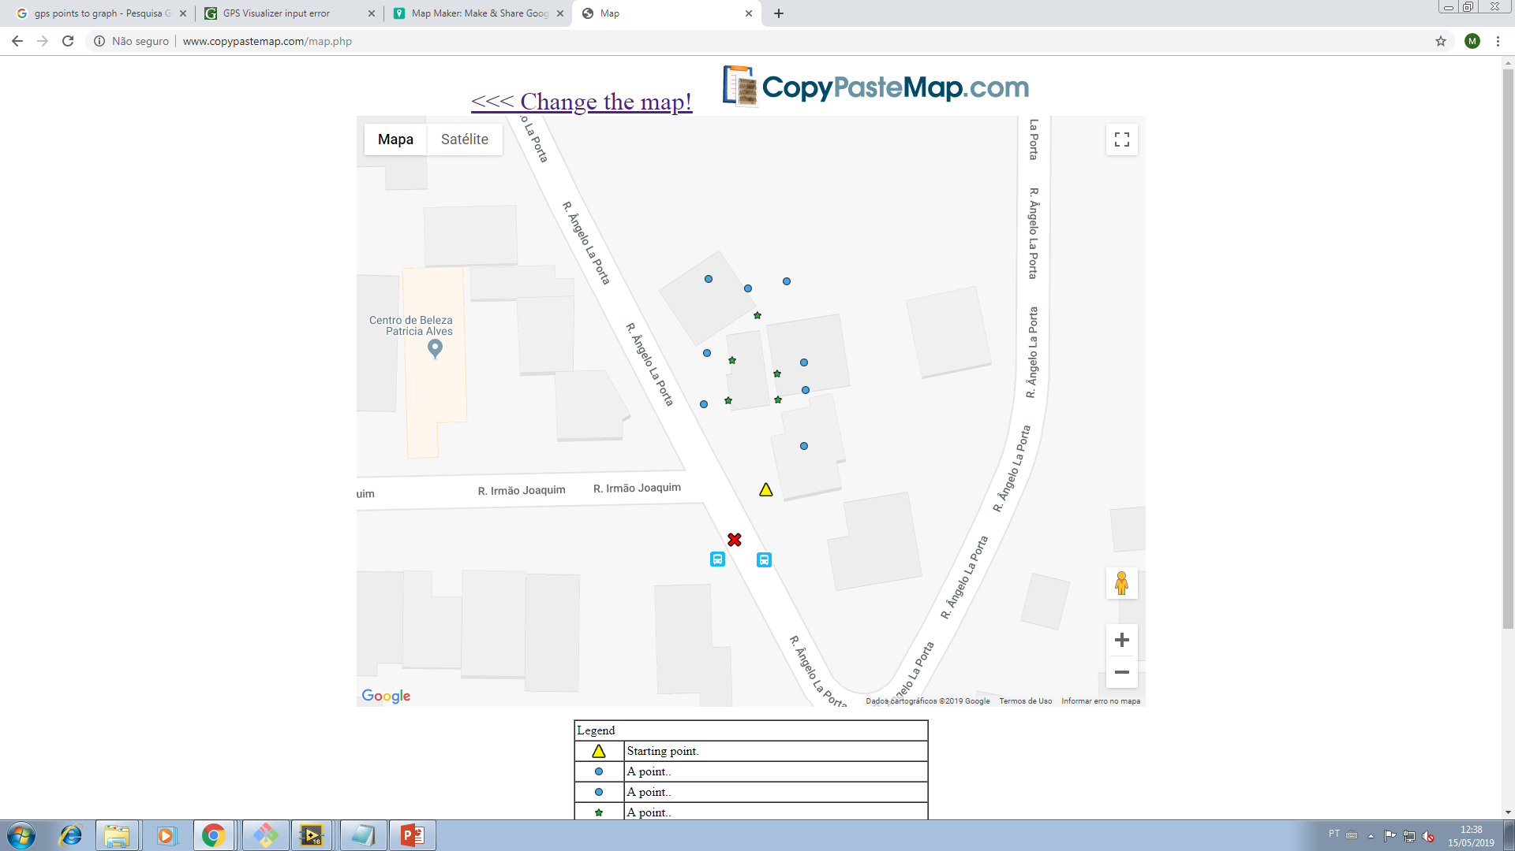
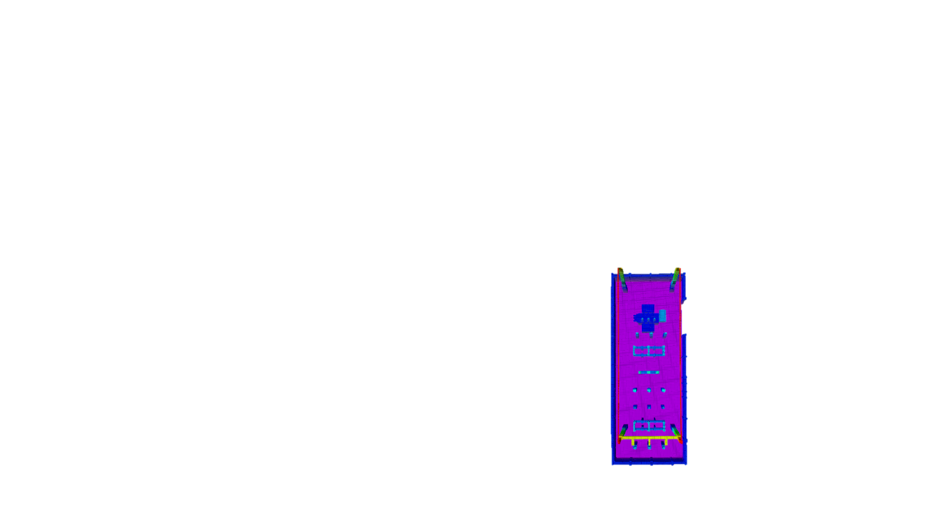

10
8
7
9
11
14
13
5
6
12
Ponto nível 1
4
3
Ponto nível 2
Ponto final
Ponto inicial
2
1
13

Slide 23
Fase 0
Fase 1
Fase 2
Fase 3

Slide 24
GERADOR ROTA: Desvio de objetos
GERADOR ROTA: Orientação do VANT
GERADOR ROTA: Lógica de adaptação
FILTRO: Validação do filtro de posições 0,5 m
CONVERSOR GPS: Validação sobre Maps
COMANDO/RESPOTA: Rota real sobre Maps
Teste a 2 m do chão;
Filtro com posições de 0,8 m;

Slide 25
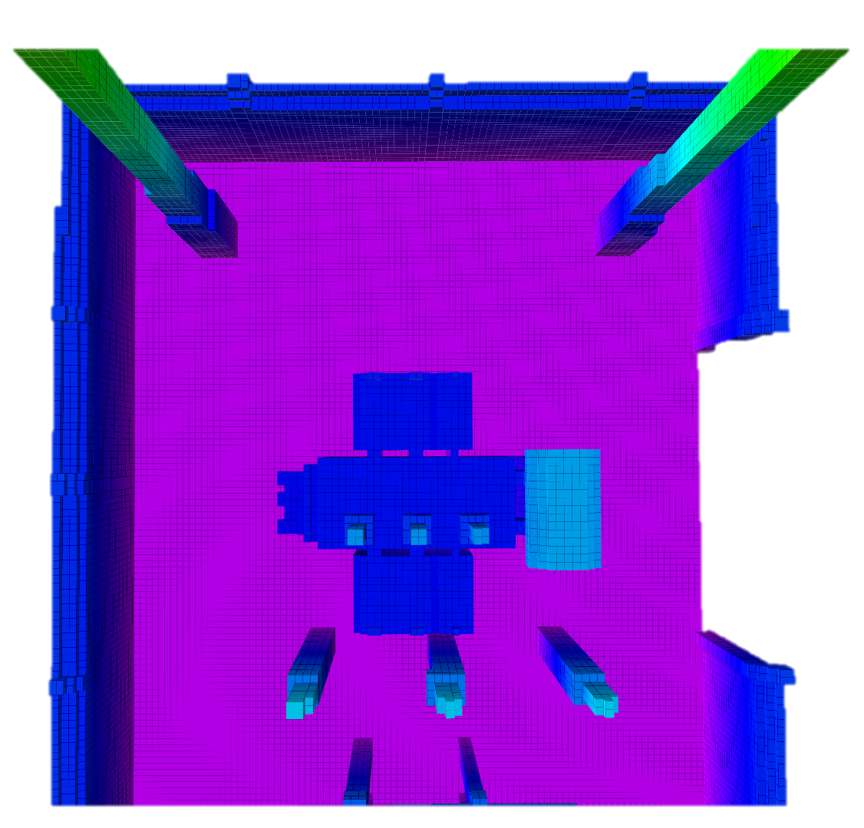
Ponto inicial
Ponto nível 1
5
1
Ponto nível 2
Ponto final
2
Rota nível 1
Rota nível 2
4

Slide 26
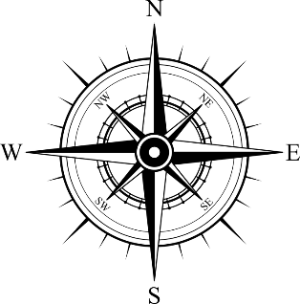
Ponto inicial
Ponto nível 1
5
1
Ponto nível 2
Ponto final
2
Rota nível 1
Rota nível 2
4

Slide 27
2
4

Slide 29
Ponto inicial
Ponto nível 1
5
1
Ponto nível 2
Ponto final
2
Rota nível 1
Rota nível 2
4
3

Slide 30
Ponto inicial
Ponto nível 1
5
1
Ponto nível 2
Ponto final
2
Rota nível 1
Rota nível 2
4
3

Slide 31
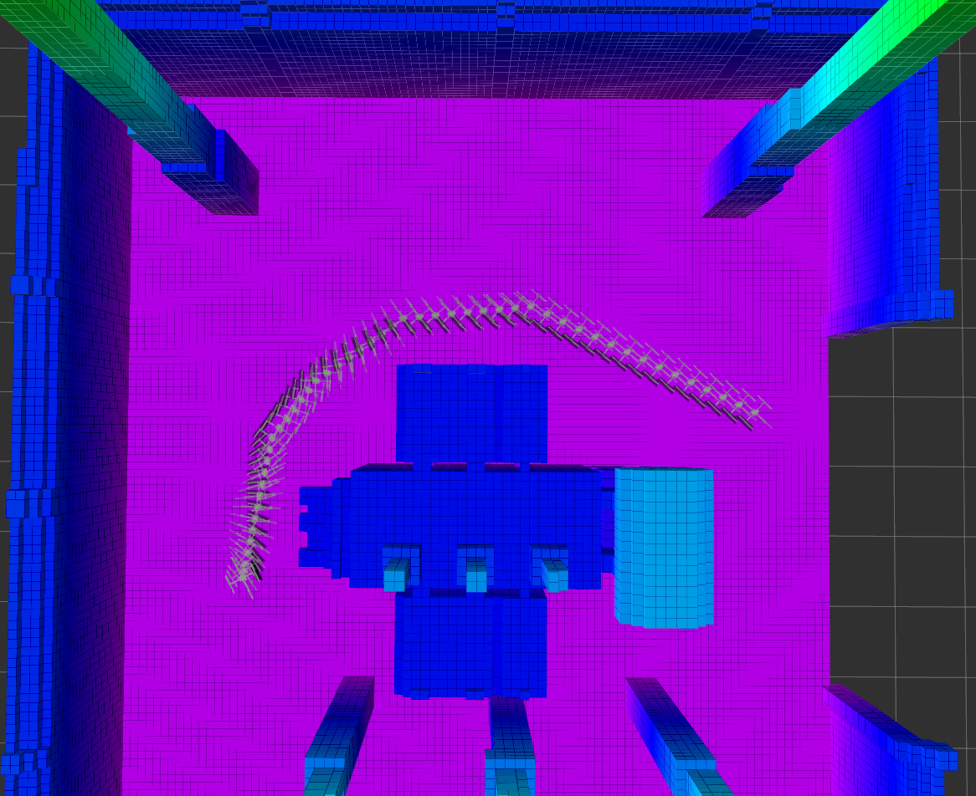

Slide 32
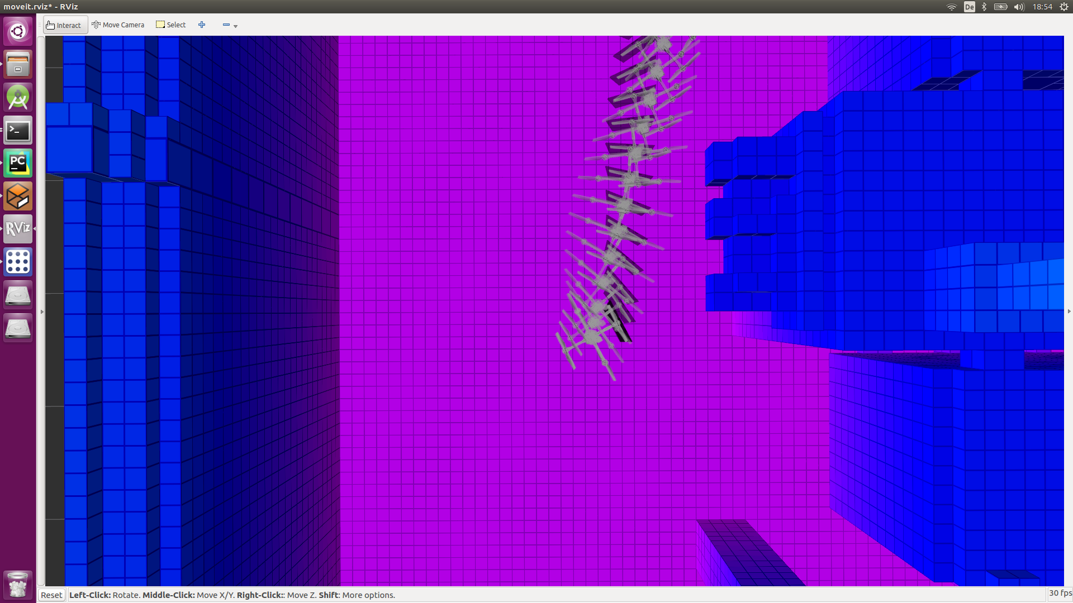
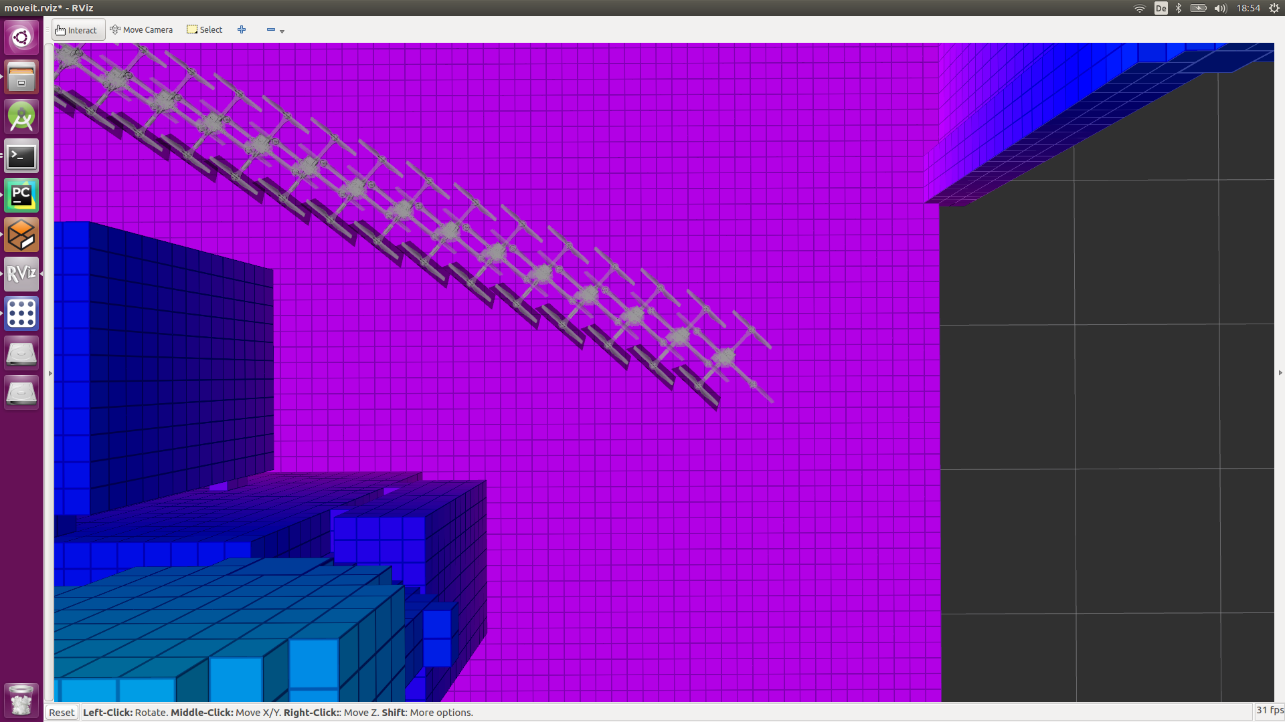

Slide 33
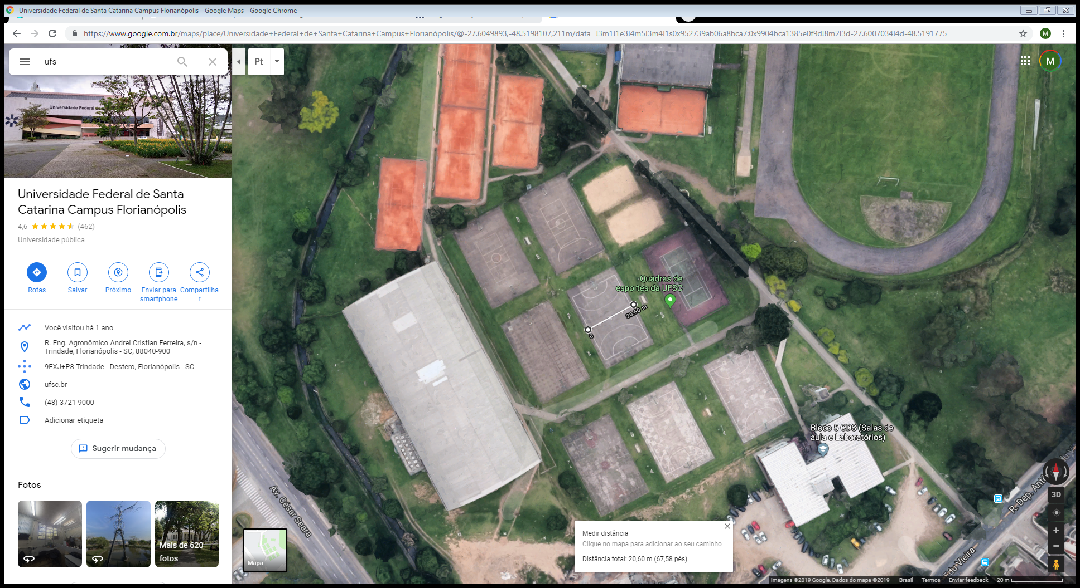

Slide 34
Teste GPS

Slide 35
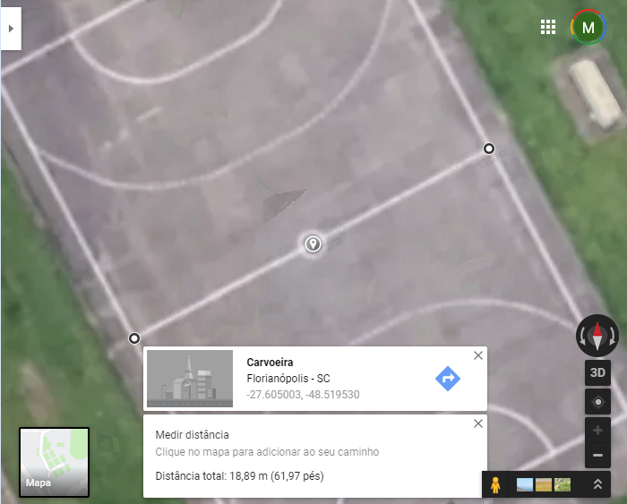
-27.605003 -48.519530

Slide 36
Teste GPS
-27.6050030128 -48.519529983 cross5 red 1 This is a fairly large cross on the map.
-27.6050083912 -48.5195244679 cross5 red 1 Legend linked to green plus.
-27.6050137696 -48.5195189528 cross5 red 1 This is a fairly large cross on the map.
-27.6050191481 -48.5195134376 cross5 red 1 Legend linked to green plus.
-27.6050191215 -48.5195134165 triangle5 green 1 This is a fairly large cross on the map.
-27.6050266782 -48.5195143916 triangle5 green 1 Legend linked to green plus.
-27.6050342348 -48.5195153667 triangle5 green 1 This is a fairly large cross on the map.
-27.6050443104 -48.5195166668 triangle5 green 1 Legend linked to green plus.
-27.6050443416 -48.5195166463 plus5 blue 1 This is a fairly large cross on the map.
-27.6050444684 -48.519525655 plus5 blue 1 Legend linked to green plus.
-27.6050445952 -48.5195346638 plus5 blue 1 This is a fairly large cross on the map.
-27.6050447219 -48.5195436725 plus5 blue 1 Legend linked to green plus.
-27.60504411 -48.5195524768 plus5 blue 1 This is a fairly large cross on the map.
-27.6050423902 -48.5195609744 plus5 blue 1 Legend linked to green plus.
-27.6050406703 -48.519569472 plus5 blue 1 This is a fairly large cross on the map.
-27.6050389352 -48.5195767617 plus5 blue 1 Legend linked to green plus.
-27.6050389522 -48.5195767993 star5 black 1 This is a fairly large cross on the map.
-27.6050310465 -48.5195760426 star5 black 1 Legend linked to green plus.
-27.6050231408 -48.5195752858 star5 black 1 This is a fairly large cross on the map.
-27.6050152351 -48.519574529 star5 black 1 Legend linked to green plus.
-27.6050075229 -48.5195720732 star5 black 1 This is a fairly large cross on the map.
-27.6049986166 -48.5195660678 star5 black 1 Legend linked to green plus.

Slide 37
-27.6050030128 -48.519529983
-27.6050191215 -48.5195134165
-27.6050443416 -48.5195166463
-27.6050389522 -48.5195767993
-27.6049986166 -48.5195660678

Slide 38
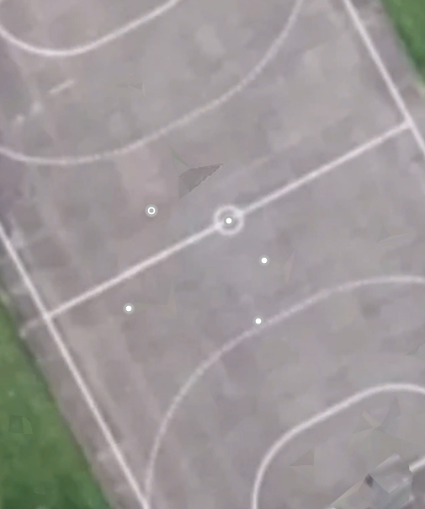

Slide 39

Ponto inicial
Ponto nível 1
5
1
Ponto nível 2
Ponto final
2
Rota nível 1
4
3
Rota nível 2

Slide 40
5
1
2
4
3

Slide 41
Teste GPS Envio/Retorno

Slide 42
Teste GPS Envio/Retorno
Preset
-27.604998649 -48.5195660665
-27.6049996636 -48.5195577407
-27.6050006782 -48.5195494149
-27.6050016928 -48.519541089
-27.6050030455 -48.5195299879
Envio
Todos
-27.6050030098 -48.5195299906
-27.605008389 -48.5195244735
-27.6050137681 -48.5195189563
-27.6050191473 -48.5195134391
-27.6050191158 -48.5195134094
-27.6050266739 -48.5195143864
-27.6050342319 -48.5195153634
-27.6050443092 -48.519516666
-27.6050443355 -48.5195166385
-27.6050444569 -48.5195249781
-27.6050445782 -48.5195333177
-27.6050446995 -48.5195416573
-27.6050457263 -48.519550577
-27.6050476341 -48.5195584089
-27.605049542 -48.5195662407
-27.6050447061 -48.5195709203
-27.6050389364 -48.5195767603
-27.6050389567 -48.5195767868
-27.6050322499 -48.5195739111
-27.6050243574 -48.5195711431
-27.6050168212 -48.519569027
-27.6050098197 -48.5195678889
-27.6049986173 -48.5195660681
Principais
-27.6050030098 -48.5195299906
-27.6050191158 -48.5195134094
-27.6050443355 -48.5195166385
-27.6050389567 -48.5195767868
-27.6049986173 -48.5195660681

Slide 43
Todos
-27.6050030098 -48.5195299906 circle2 red 1 This is a fairly large cross on the map.
-27.605008389 -48.5195244735 circle2 red 1 This is a fairly large cross on the map.
-27.6050137681 -48.5195189563 circle2 red 1 This is a fairly large cross on the map.
-27.6050191473 -48.5195134391 circle2 red 1 This is a fairly large cross on the map.
-27.6050191158 -48.5195134094 circle2 red 1 This is a fairly large cross on the map.
-27.6050266739 -48.5195143864 circle2 red 1 This is a fairly large cross on the map.
-27.6050342319 -48.5195153634 circle2 red 1 This is a fairly large cross on the map.
-27.6050443092 -48.519516666 circle2 red 1 This is a fairly large cross on the map.
-27.6050443355 -48.5195166385 circle2 red 1 This is a fairly large cross on the map.
-27.6050444569 -48.5195249781 circle2 red 1 This is a fairly large cross on the map.
-27.6050445782 -48.5195333177 circle2 red 1 This is a fairly large cross on the map.
-27.6050446995 -48.5195416573 circle2 red 1 This is a fairly large cross on the map.
-27.6050457263 -48.519550577 circle2 red 1 This is a fairly large cross on the map.
-27.6050476341 -48.5195584089 circle2 red 1 This is a fairly large cross on the map.
-27.605049542 -48.5195662407 circle2 red 1 This is a fairly large cross on the map.
-27.6050447061 -48.5195709203 circle2 red 1 This is a fairly large cross on the map.
-27.6050389364 -48.5195767603 circle2 red 1 This is a fairly large cross on the map.
-27.6050389567 -48.5195767868 circle2 red 1 This is a fairly large cross on the map.
-27.6050322499 -48.5195739111 circle2 red 1 This is a fairly large cross on the map.
-27.6050243574 -48.5195711431 circle2 red 1 This is a fairly large cross on the map.
-27.6050168212 -48.519569027 circle2 red 1 This is a fairly large cross on the map.
-27.6050098197 -48.5195678889 circle2 red 1 This is a fairly large cross on the map.
-27.6049986173 -48.5195660681 circle2 red 1 This is a fairly large cross on the map.

Slide 44
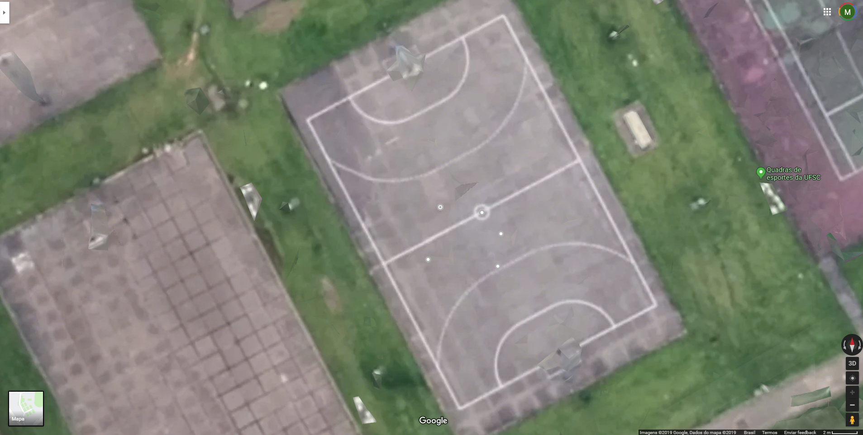

Slide 45
Teste GPS Envio/Retorno
Retorno
Principais
-27.6050038655 -48.519523064
-27.6050233768 -48.5195091899
-27.6050509603 -48.5195175906
-27.6050357309 -48.5195801182
-27.604992714 -48.5195650491
Todos no arquivo na pasta

Slide 46
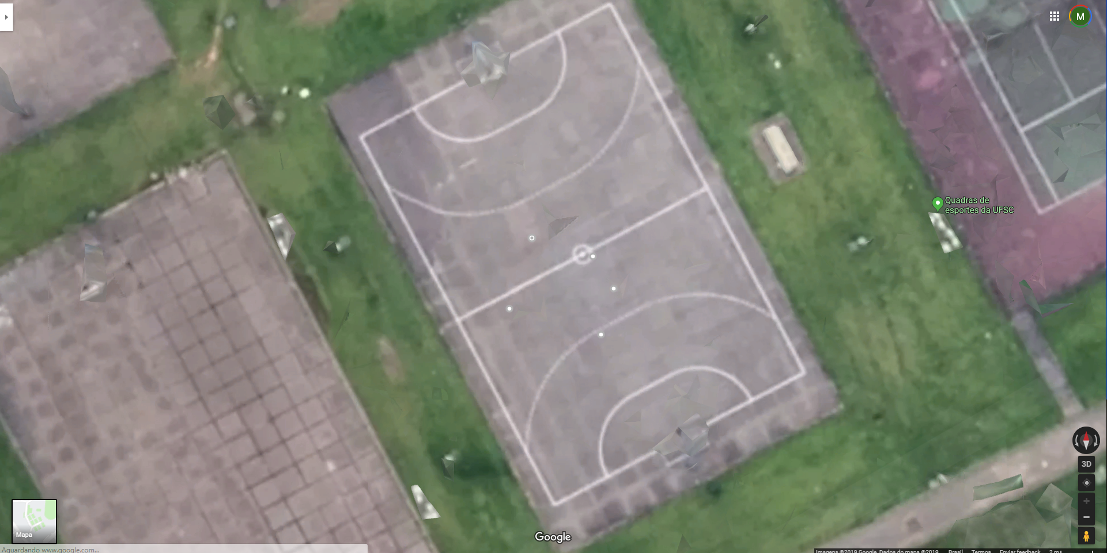

Slide 47
Comparação

Slide 48
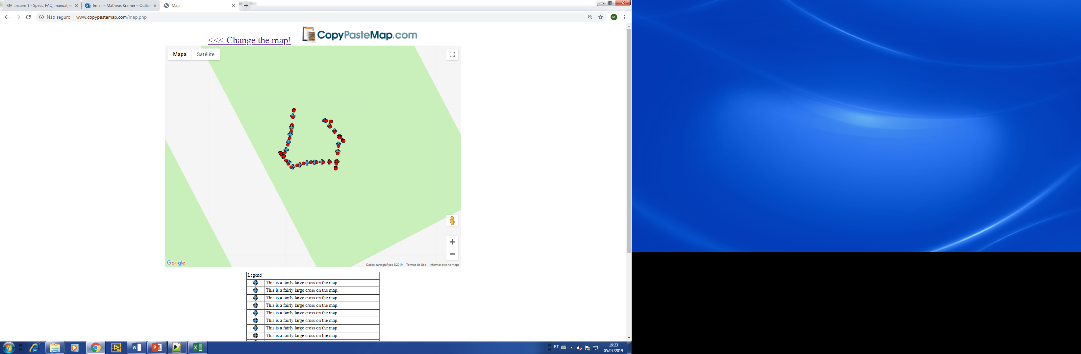
Pontos comandados
Pontos recebidos

Slide 49
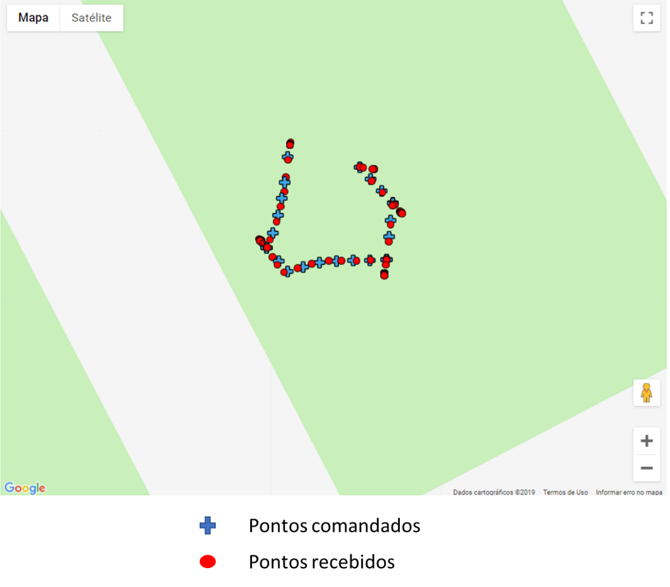
Pontos comandados
Pontos recebidos

Slide 50
Comando
Retorno
-27.6050030098 -48.5195299906
-27.6050191158 -48.5195134094
-27.6050443355 -48.5195166385
-27.6050389567 -48.5195767868
-27.6049986173 -48.5195660681
2.01425293983
2.01475906577
2.01541081051
2.01446971725
2.01565377887
-27.6050038655 -48.519523064
-27.6050233768 -48.5195091899
-27.6050509603 -48.5195175906
-27.6050357309 -48.5195801182
-27.604992714 -48.5195650491
2.29999995232
2.29999995232
2.20000004768
2.79999995232
2.59999990463

Slide 51

Pontos comandados
Pontos recebidos

Slide 52
Pontos comandados

